Slide 1
FLIGHT DELAY ANALYSIS
~ Abdulkadir Indorewala

Slide 2
Overview
Air travel generates massive amounts of data daily.
Objective: analyze flight data to identify trends, delays, cancellations, and inefficiencies.
Tools used:
SQL → for querying, cleaning, and extracting insights.
Power BI → for creating dashboards and visualizations.
Dataset includes: Flight ID, Airline, Origin, Destination, Distance, Departure/Arrival times, Delays, Cancellations.
Challenges: missing data, inconsistencies, anomalies in records.
Goal: generate actionable recommendations for stakeholders (airlines, airports, authorities).

Slide 3
Tools and Methodology
SQL - used for cleaning, filtering, aggregating (delays, cancellations by airline/airport).
Power BI - used to build dashboards with visuals for time, airline, and airport analysis.
Data quality issues: Many missing values in delay columns (Weather, Airline, Late Aircraft). Some columns like SCHEDULED_TIME have almost no values → not reliable.

Slide 4
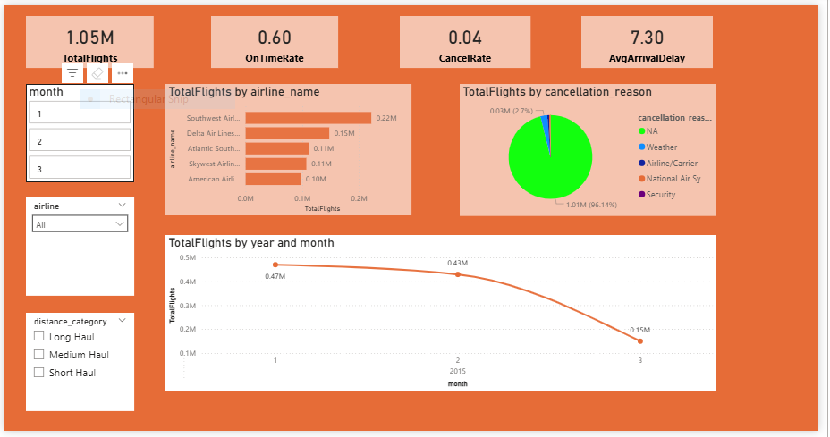
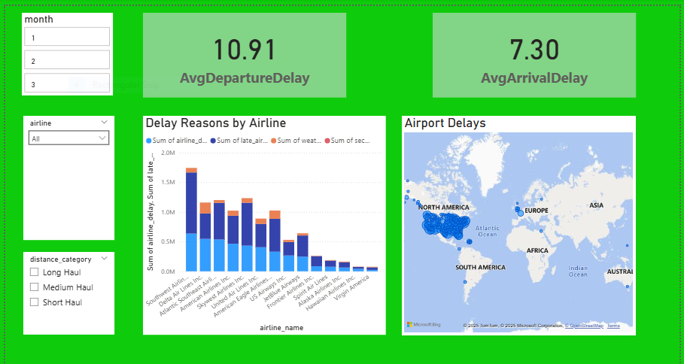
Dashboard Highlights

Slide 5
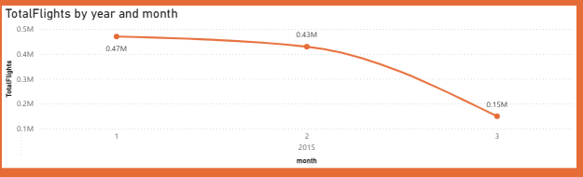
Insight 1 – Total Flights by Year and Month

Slide 6
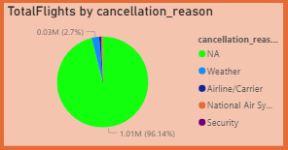
Insight 2 – Total Flights by Cancellation Reason

Slide 7
Recommendations
Airlines: Increase staffing and maintenance checks during evening hours → reduce late-day delays.
Airports: Major hubs (ORD, ATL) should allocate extra slots during peak evening hours to ease congestion.
Policy Makers: Track airlines with high cancellation rates (esp. due to "Airline" reasons) → enforce accountability.

Slide 8
Conclusion
Dataset shows clear patterns: Evening congestion, airline-driven cancellations, and major hub bottlenecks.
Implementing targeted scheduling, better airline management, and accountability measures can reduce delays.
Future work: Predictive modeling for delays, passenger sentiment analysis.

